Slide 1
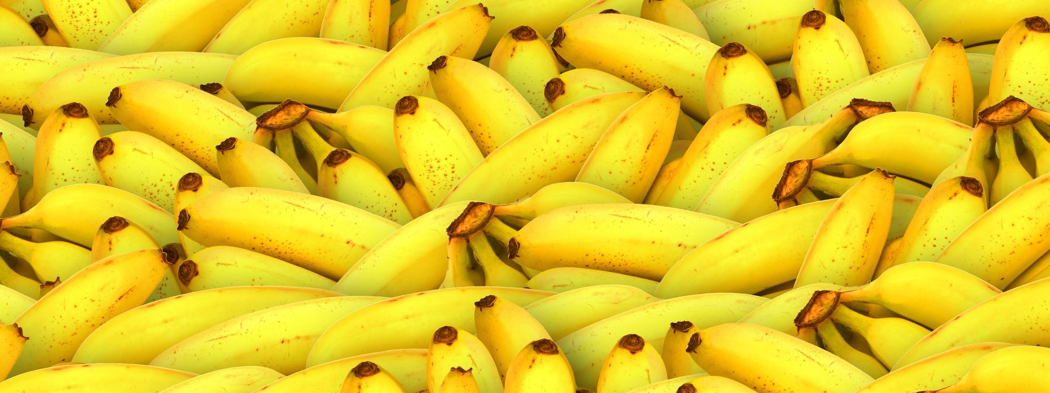
Banana (Group #2)
Team composed of: Amanda Cervantes, Miles Green, Hao Sheng, Louis Shu, and Bryce Williams

Slide 2
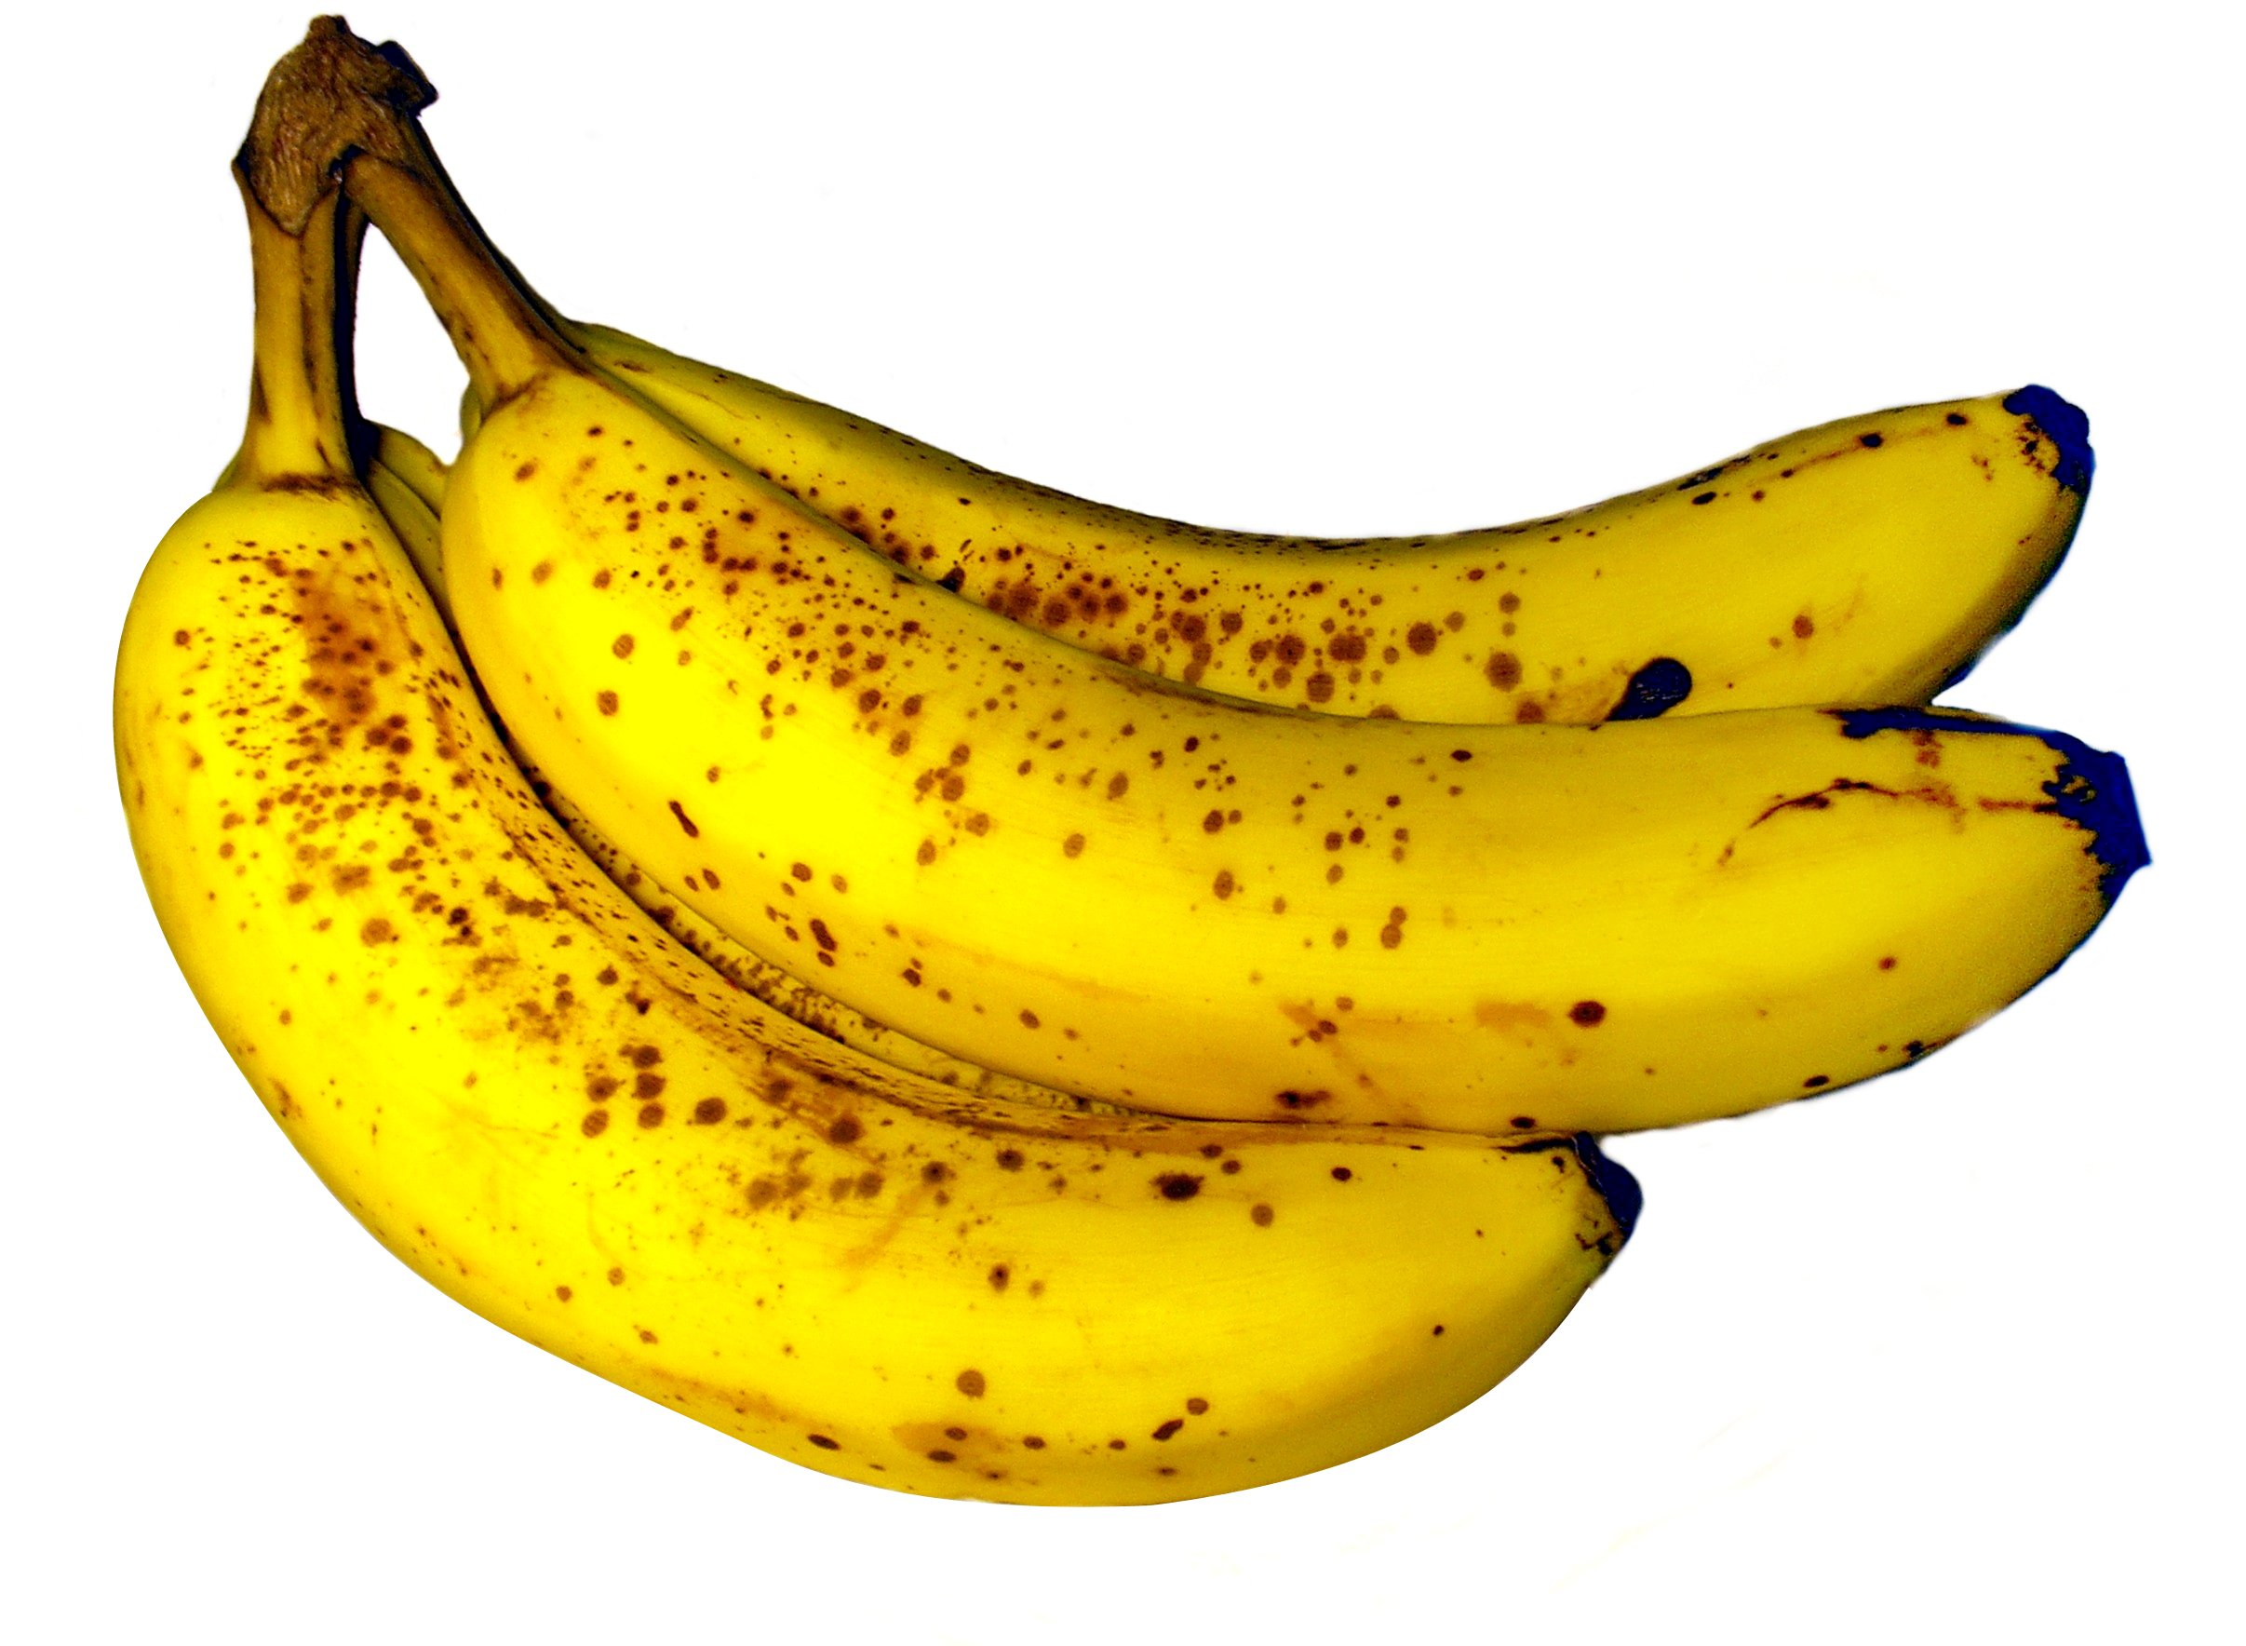
Git Repository
We’ve decided to use the git repository GitHub and name our project Banana. We chose this name for its similarity to the fruit apple, the name of one of the largest technology companies.

Slide 3
About our Team Members

Slide 4

Amanda Cervantes
Hometown: Houston, TX
Major: Bioinformatics, Pre-Med
I chose bioinformatics because I thought it would be an innovative way to combine my love for medicine along with computer science. With this major, I’d be able to implement computer science into pediatric oncology.
Something Interesting: Every other school I applied to, I was a biomedical engineer.
Primary Roles and Responsibilities:
The group liaison
Title screen
Scores
Movement of characters

Slide 5

Miles Greene
Hometown: Gilroy, CA
Major: Computer Science (Software Engineering)
I chose software engineering because it is an interesting subject with great job opportunities.
Something Interesting: I love to play basketball.
Primary Roles and Responsibilities:
Creation of the background and different levels
Movement of characters
Fireballs

Slide 6
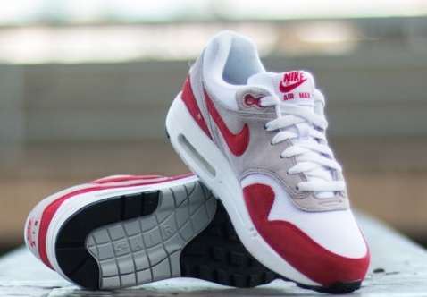
Hao Sheng
Hometown: Atlanta,GA
Major: Computer Science
I am interested in creating and building products.
Something Interesting: I like to wear Nike shoes.
Primary Roles and Responsibilities:
Creation of Mario
Movement of the characters
Coins

Slide 7
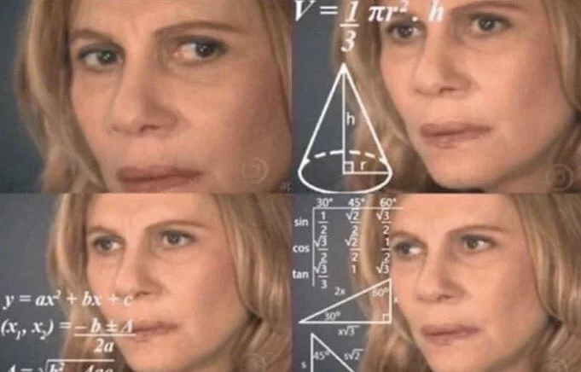
Luntian Shu
Hometown: China
Major: Mathematics
I chose to major in math because I think it will be helpful when I go to apply for a graduate program.
Something Interesting: I am currently a senior at Baylor.
Primary Roles and Responsibilities:
Create the turtles
Create the mushrooms
Movement of the characters

Slide 8
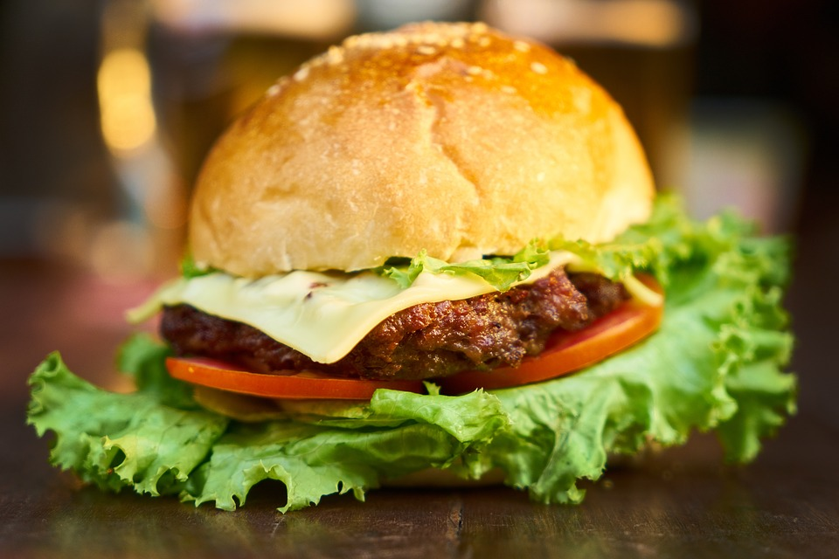
Bryce Williams
Hometown: Dallas, TX
Major: Statistics
I chose statistics because I plan on becoming a sports statistician where I can combine my knowledge of sports and math.
Something Interesting: “A burger a day keeps the doctor away”
Primary Roles and Responsibilities:
Creation of Luigi
Movement of the characters
Coins

Slide 9
Progress We’ve Made
Tutorials Completed:
We’ve all completed at least tutorials 1-6 on lazyfoo.com
We’ve also researched different Youtube tutorials to help us install SDL and SDL mixer
The Hello World Tutorial on GitHub
Design of the Project:
Clean
Understandable
Easy to Play, but with harder levels
We’ve also done research on the game to outline what specific movements and characters the game is going to need.

Slide 10
Areas of Concern
Timing
Character Replication (how similar the characters will look)
How all the code is going to come together
Fluidity of movement
Creation of the code

